Slide 1




INTRODUCTION TO
Introduction of Electronics
Module 2 – Robotics and Automation Systems
PRESENTED BY
DATE OF SESSION
Mr Rajesh
June 2026

Slide 2
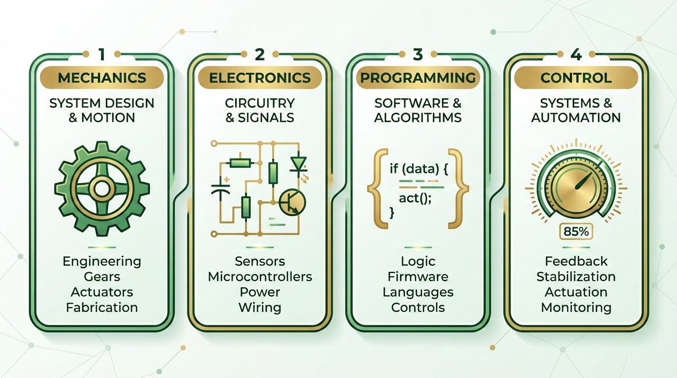

Module Overview
Key topics covered in electronics for robotics:
What electronics means
Why electronics is used in robotics
Basic electricity concepts
Voltage, resistance, and current
Ohm’s Law applications
Series and parallel resistance
Introduction of Electronics | Robotics and Automation Systems

Slide 3

Learning Objectives
By the end of this module, students will learn to:
Define electronics
Explain electricity and its types
Understand voltage and resistance
Apply Ohm’s Law
Use the resistor color code
Introduction of Electronics | Robotics and Automation Systems

Slide 4


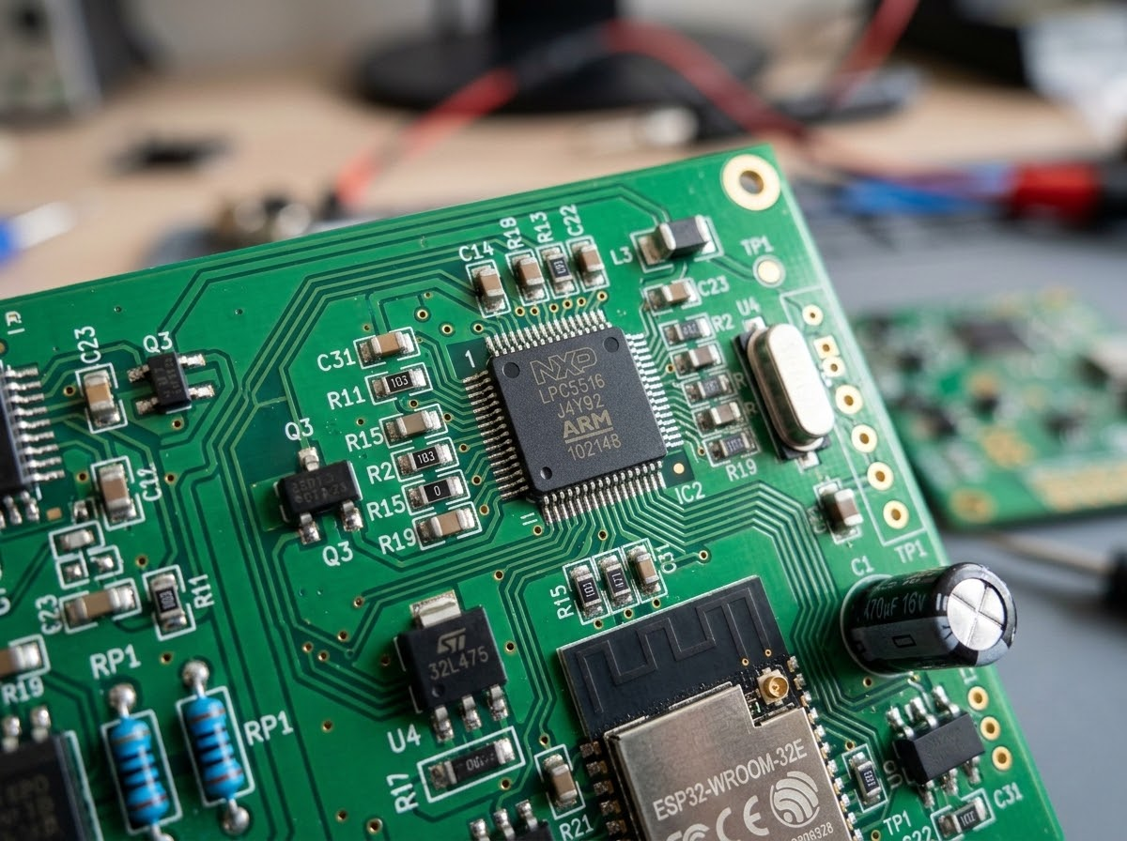
What is Electronics?
DEFINITION
“Electronics is the study and use of electrical components to control the flow of current in circuits.”
Foundational concept for Robotics and Automation
Systems, enabling precise control of robotic behavior.
Introduction of Electronics | Robotics and Automation Systems

Slide 5

Electronics in Daily Life
Everyday applications include:
Mobile phones
Televisions
Computers
Sensors
Robots
Automation machines
Integrated Electronics: From Mobile Code to Robotic Execution
Introduction of Electronics | Robotics and Automation Systems

Slide 6

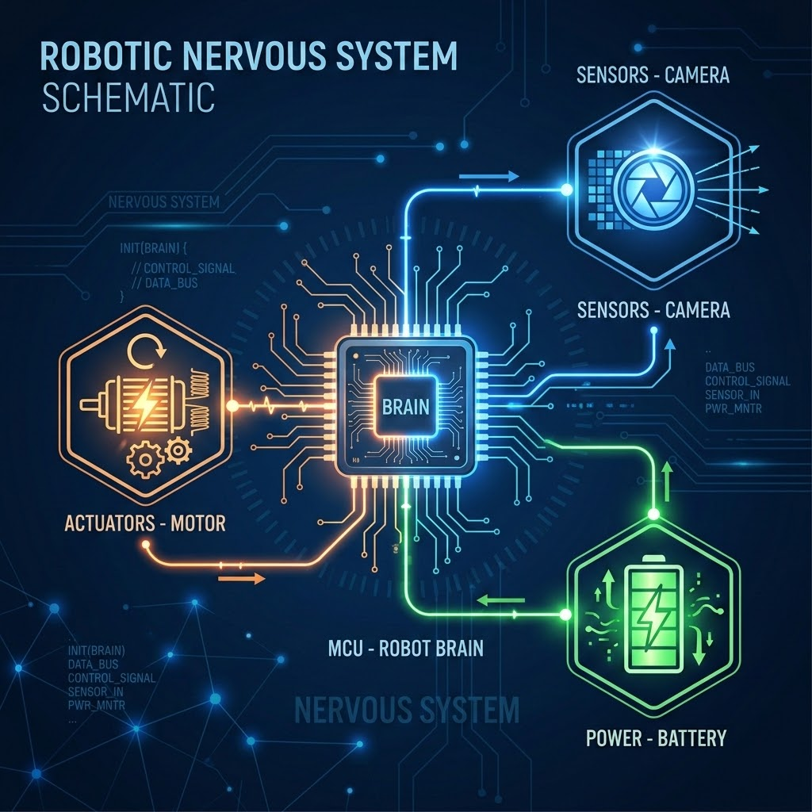



Why Electronics is Used in Robotics
Electronics form the nervous system of a robot:
Controls Robot Movement
Sends and Receives Signals
Reads Sensor Data
Makes Automation Possible
Powers Motors
ROBOT BRAIN
Introduction of Electronics | Robotics and Automation Systems

Slide 7

Electronics and Robotics Connection
INPUT
PROCESS
OUTPUT
sensors
memory
settings_input_component
Sensors give input data from the environment.
The Controller processes the data.
Motors and actuators create the physical output.
Introduction of Electronics | Robotics and Automation Systems

Slide 8

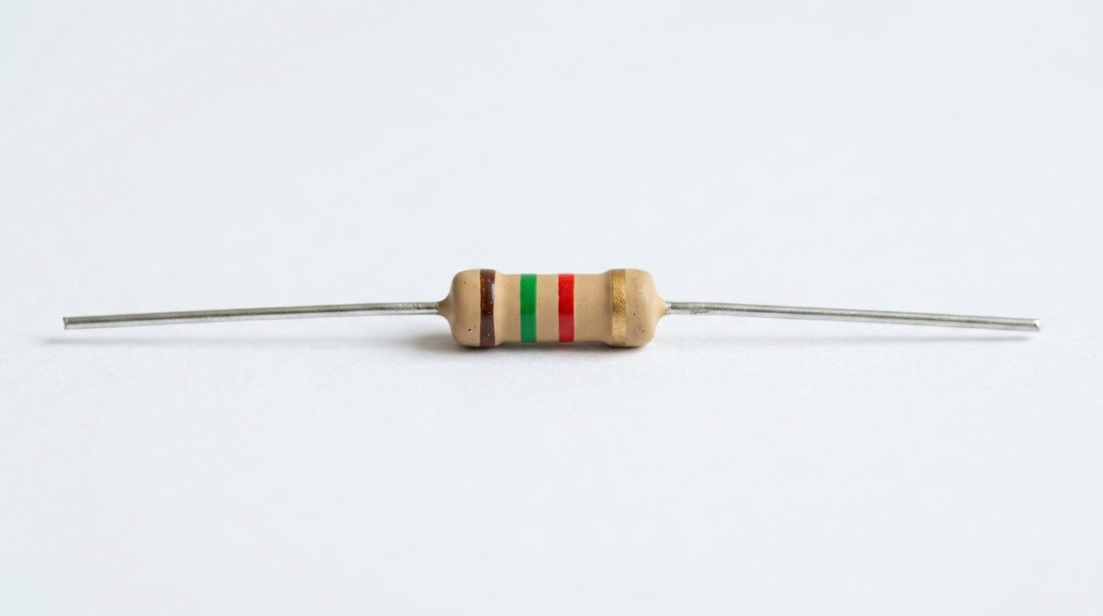
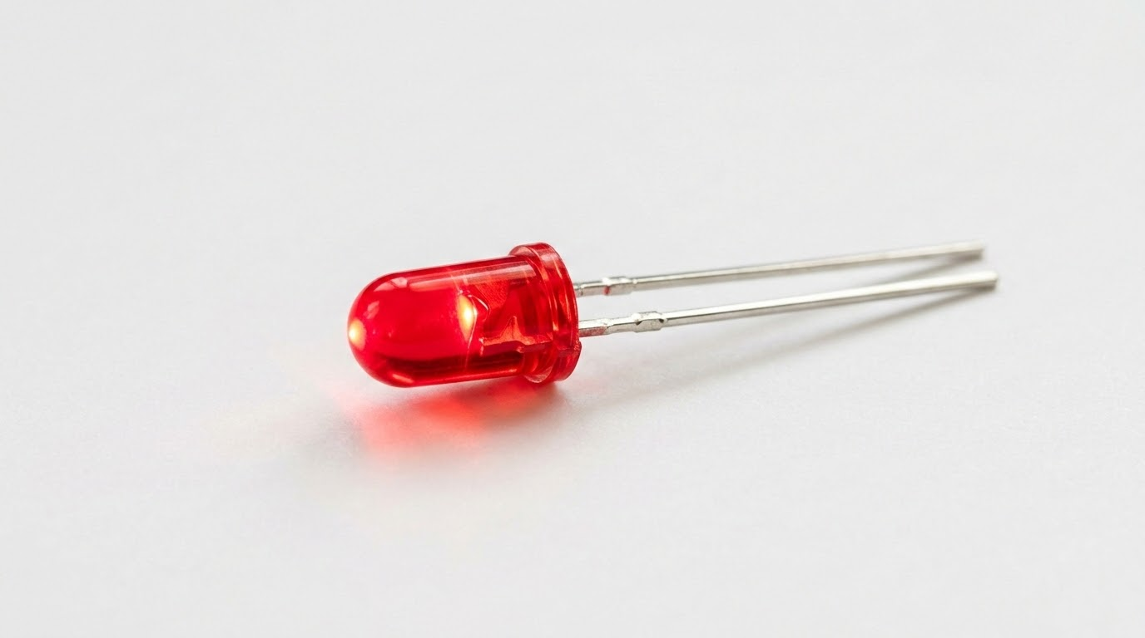
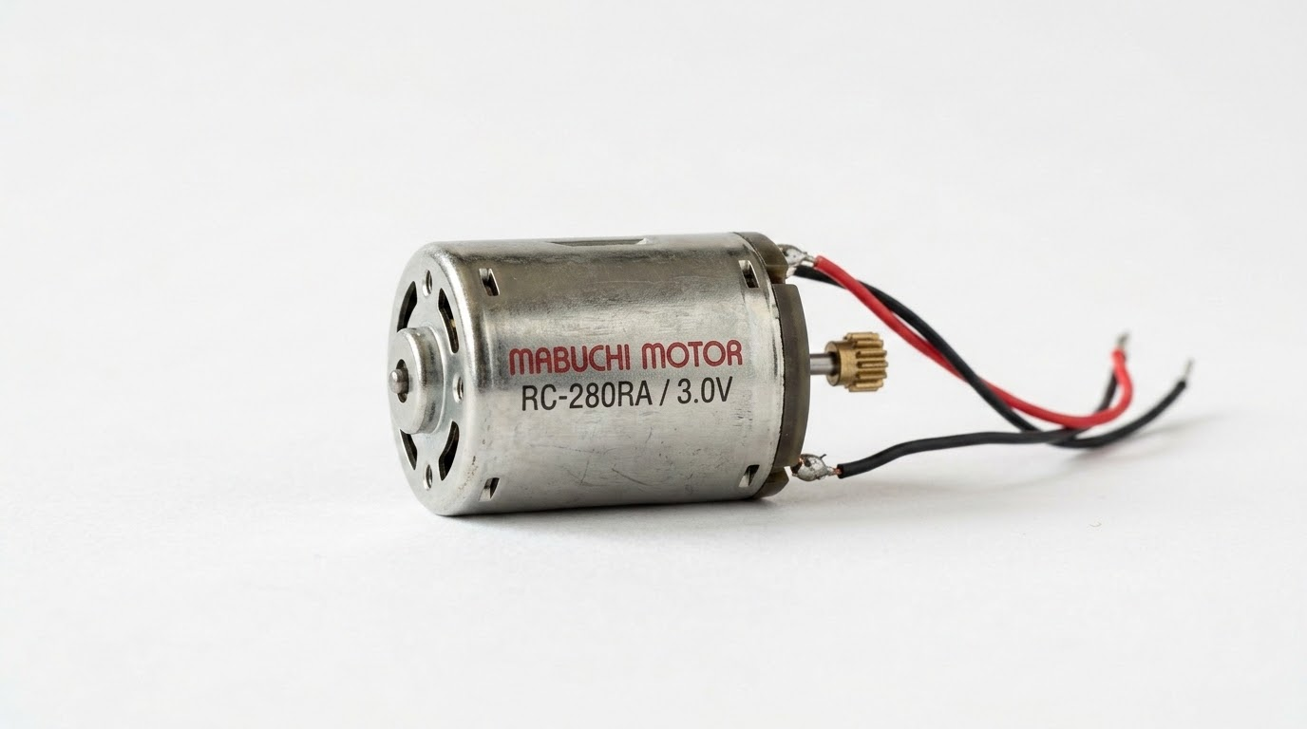
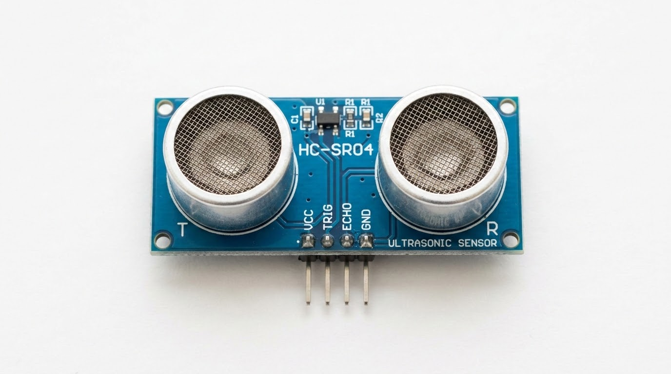
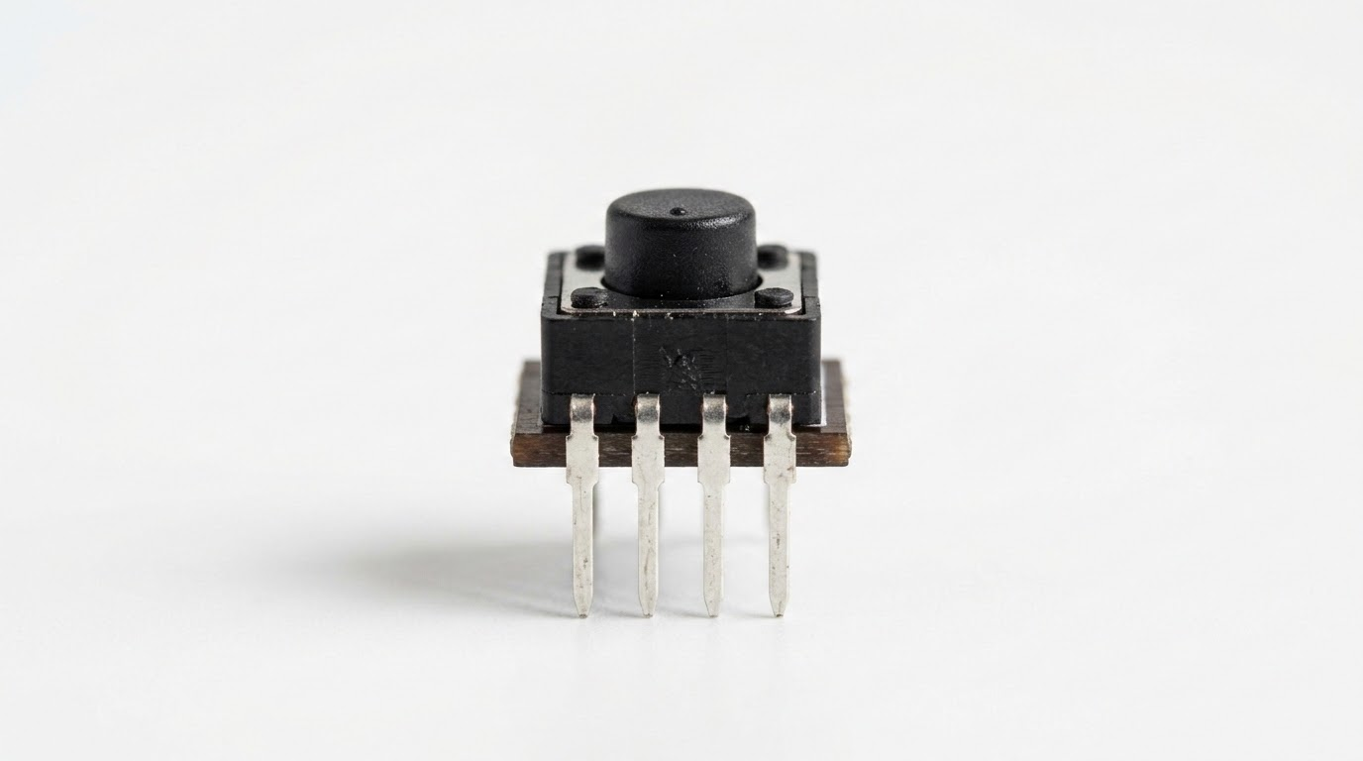
Basic Electronic Components
Battery
Resistor
LED
Government of Sindh | University of Sindh
08
Motor
Sensor
Switch

Slide 9
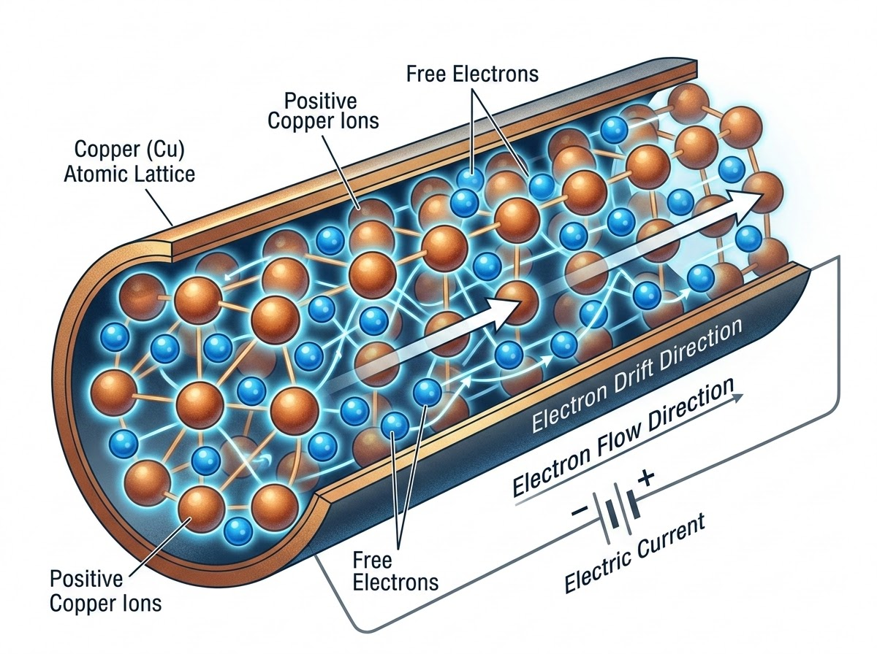
What is Electricity?
DEFINITION
"Electricity is the movement or presence of electric charge."
Fig 1.1: Atomic lattice and electron drift representation.
Introduction of Electronics | Robotics and Automation Systems

Slide 10
Types of Electricity
Two main categories:
Static Electricity
Current Electricity
stop
Charge stored on the surface of an object.
stop
Continuous flow of electric charge.
Introduction of Electronics | Robotics and Automation Systems

Slide 11

Static Electricity
Characteristics
Charge is stored on the surface of an object.
Does not flow continuously.
Examples
Rubbing a balloon on hair
Lightning strikes
Introduction of Electronics | Robotics and Automation Systems

Slide 12
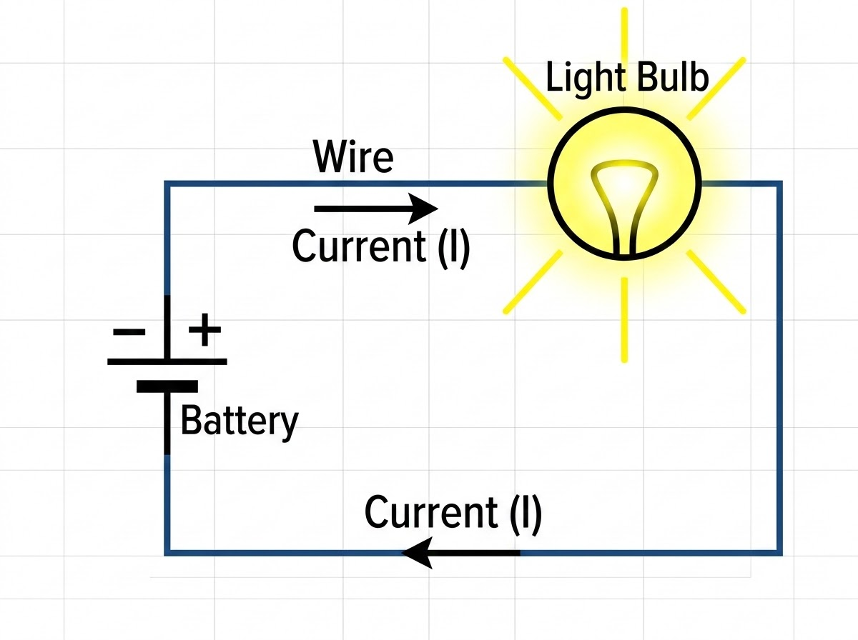
Current Electricity
Characteristics
The continuous flow of electric charge.
Travels through a conductor (like copper wire).
Powers electronic devices and circuits.
Introduction of Electronics | Robotics and Automation Systems

Slide 13
Types of Current Electricity
Direct Current (DC)
The unidirectional flow of electric charge. The current flows in a constant direction with a steady voltage level.
Commonly Used In:
Batteries
Electronic devices
Solar panels
Alternating Current (AC)
An electric current which periodically reverses direction and changes its magnitude continuously with time.
Commonly Used In:
Home power outlets
Industrial motors
Long-distance transmission
Waveform Comparison
DC
AC
Visual representation of voltage over time
Government of Sindh | University of Sindh
13

Slide 14
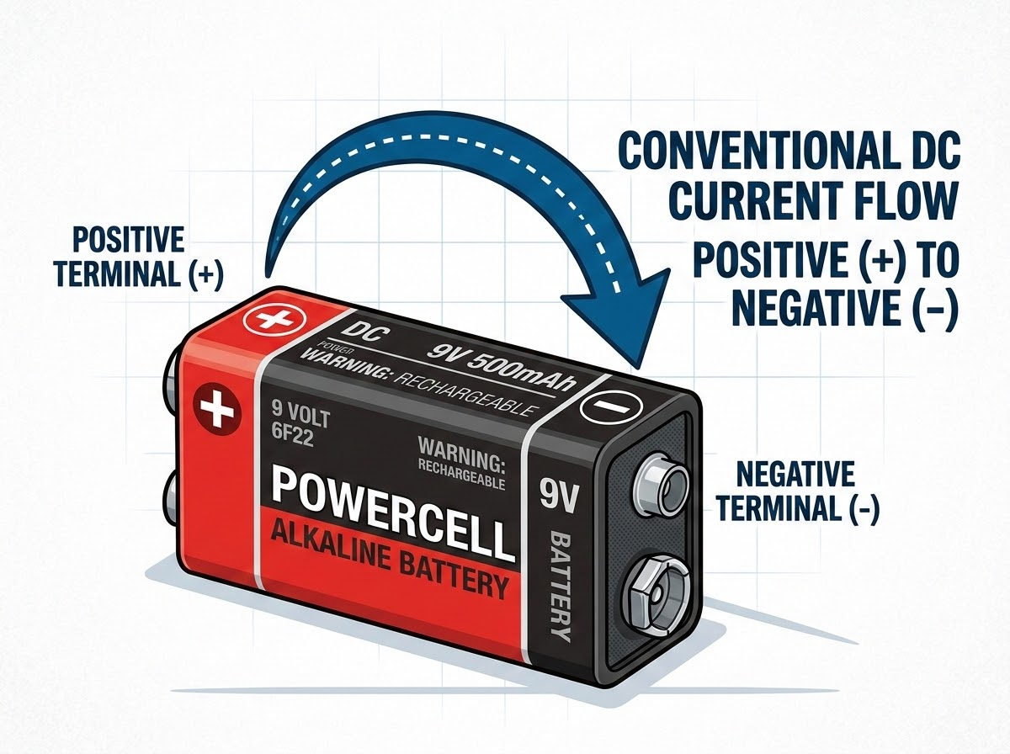
Direct Current (DC)
Flow: One direction only.
Common Uses:
Batteries
Arduino boards
Robots
DC motors
Introduction of Electronics | Robotics and Automation Systems

Slide 15
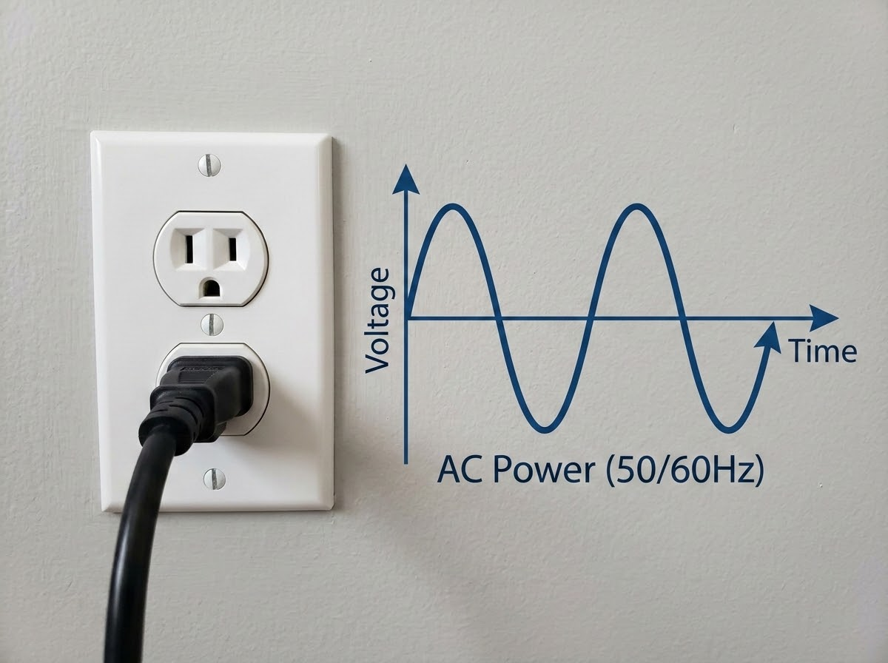
Alternating Current (AC)
Flow: Changes direction repeatedly.
AC Waveform & Source
Common Uses:
Home electricity (wall outlets)
Ceiling fans
Household appliances
Heavy industrial machines
Introduction of Electronics | Robotics and Automation Systems

Slide 16
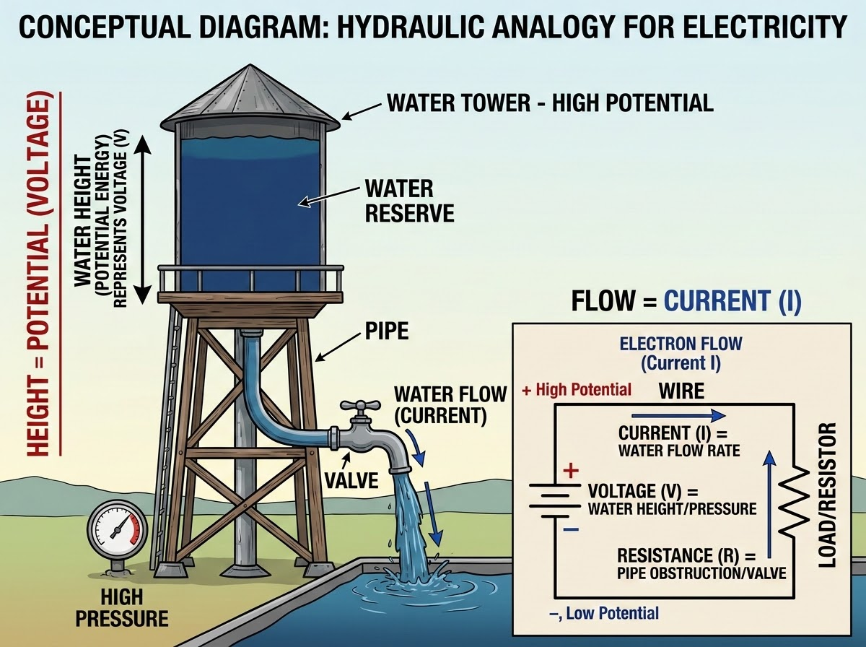
Voltage
Definition
The electrical pressure that pushes current through a circuit.
Unit of Measurement
Volt (V)
Analogy
Water pressure in a pipe.
Introduction of Electronics | Robotics and Automation Systems

Slide 17
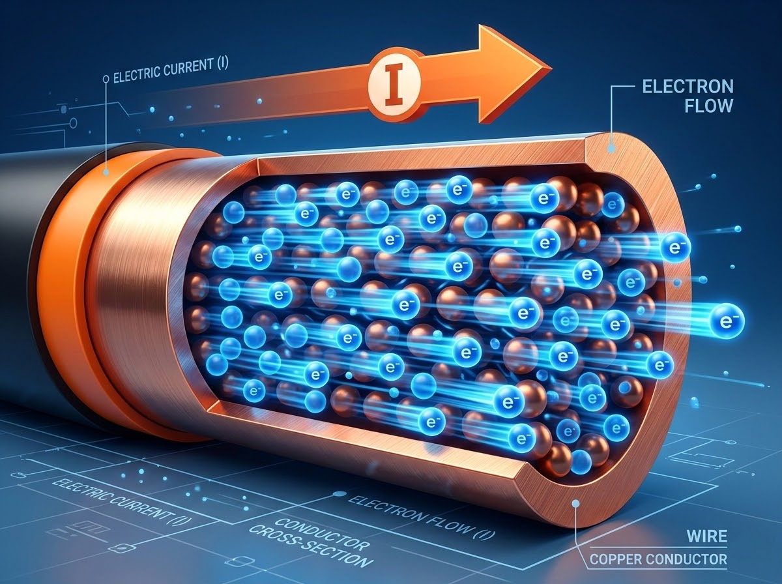
Current
Core Concepts
Definition: The actual flow of electric charge in a circuit.
Unit of Measurement: Ampere (A)
Analogy: The amount of water flowing through a pipe.
Introduction of Electronics | Robotics and Automation Systems

Slide 18
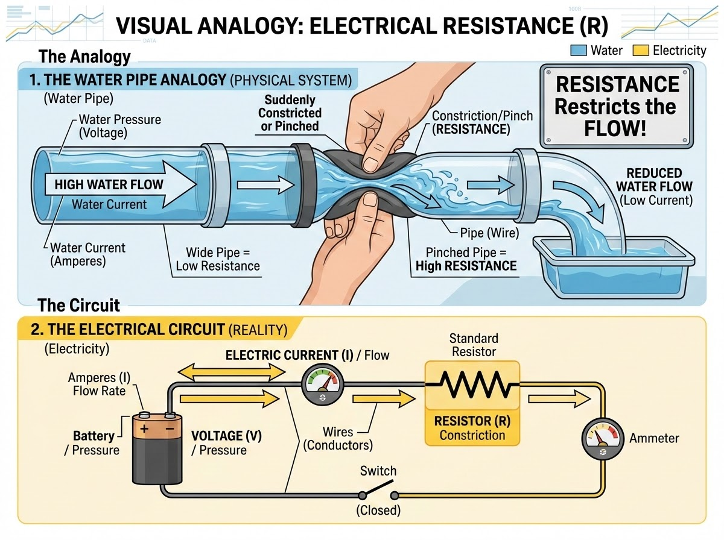
Resistance
Definition
The property that opposes the flow of current.
Unit of Measurement
Ohm (Ω)
Analogy
A narrow section or pinch in a water pipe.
Introduction of Electronics | Robotics and Automation Systems

Slide 19
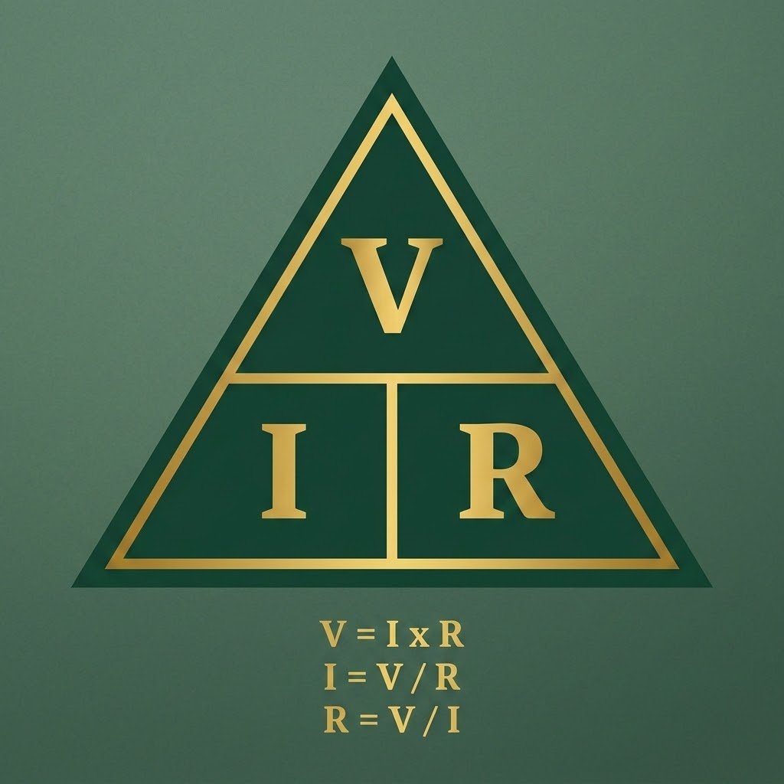
Ohm’s Law
V = I × R
Definitions:
V = Voltage (Measured in Volts)
I = Current (Measured in Amperes)
R = Resistance (Measured in Ohms)
Introduction of Electronics | Robotics and Automation Systems

Slide 20

Ohm’s Law Example
Solved Circuit Calculation:
Given
Current (I) = 2A, Resistance (R) = 5Ω
Formula
V = I × R
Calculation
V = 2 × 5
Result
V = 10V
Introduction of Electronics | Robotics and Automation Systems
03

Slide 21
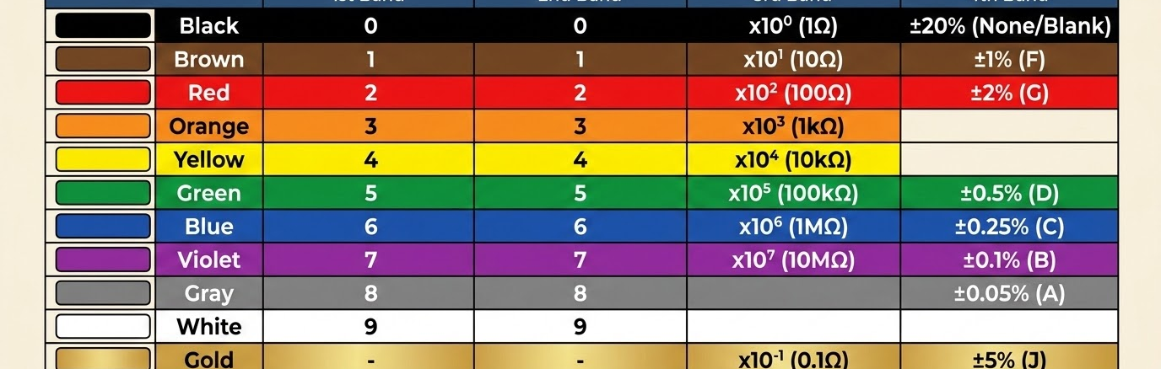
Resistance Color Code Table
Decoding Resistor Values:
Resistors use standard colored bands printed on their bodies to indicate their exact resistance value in Ohms.
Introduction of Electronics | Robotics and Automation Systems

Slide 22
How to Read a Resistor
Band Positions
MULTIPLIER
1ST DIGIT
1st Band: First digit of the resistance value.
2nd Band: Second digit of the resistance value.
3rd Band: Multiplier (represents the number of zeros following the first two digits).
4th Band: Tolerance (represents the precision or accuracy percentage).
2ND DIGIT
TOLERANCE
Introduction of Electronics | Robotics and Automation Systems

Slide 23
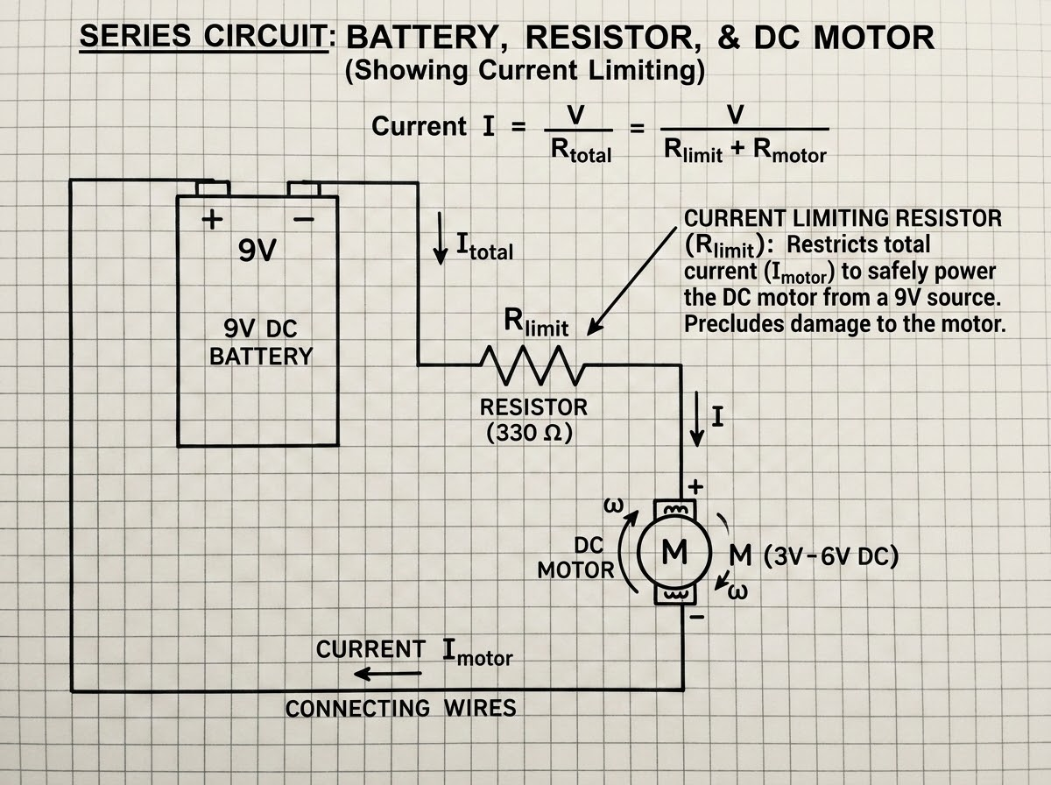
Finding Resistance
Protecting Components
Purpose: Use resistance to limit current and protect sensitive parts (like LEDs or motors).
Ohm's Law Formula
R = V / I
Where R is Resistance (Ohms), V is Voltage (Volts), and I is Current (Amperes).
Introduction of Electronics | Robotics and Automation Systems

Slide 24
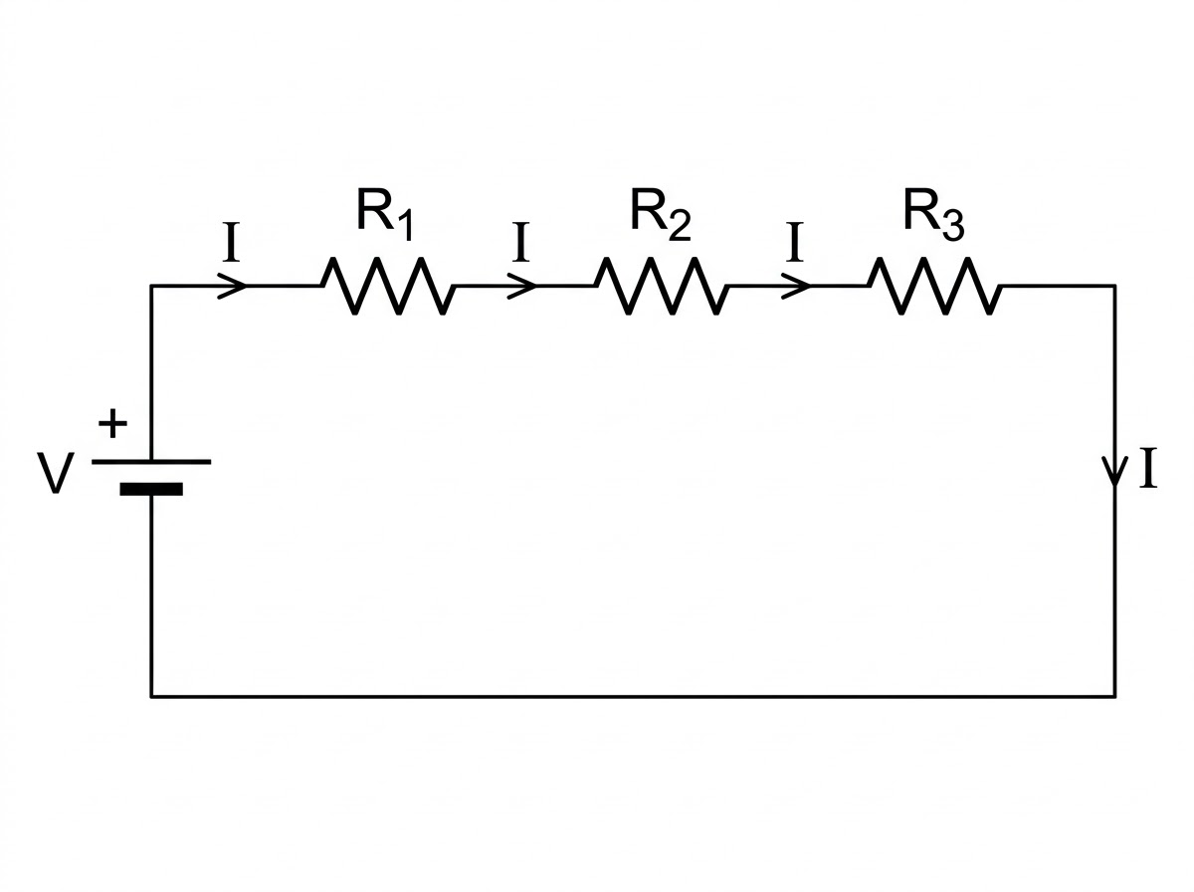
Series Resistance
Conceptual Overview
Definition: Resistors connected sequentially, end-to-end.
Current Path: There is only one path for the current to flow.
Total Resistance Formula
Rtotal = R1 + R2 + R3
Introduction of Electronics | Robotics and Automation Systems

Slide 25
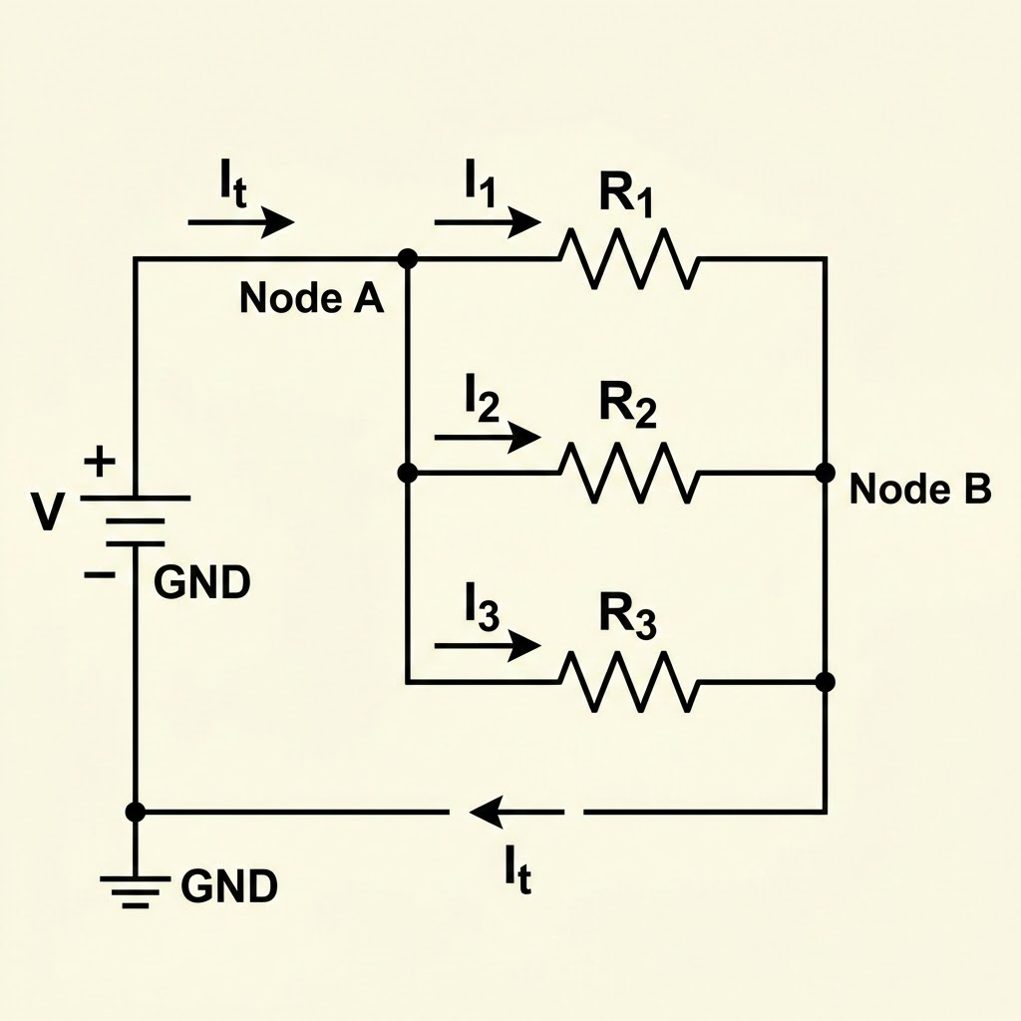
Parallel Resistance & Module Summary
Parallel Circuits
Module Wrap-Up
Resistors provide multiple paths for current.
Electronics controls robots.
Electricity powers circuits.
Voltage pushes current.
Resistance controls current.
Ohm’s Law calculates circuit values.
Introduction of Electronics | Robotics and Automation Systems

